Slide 1
Getting started: Workshop on Vaccine Evaluation
Create a free account on the Rstudio Cloud: https://rstudio.cloud/
** Please do this even if you already have Rstudio installed on your computer!
2) Join the Workspace titled “Vaccine Evaluation Workshop” (by invitation)
3) Open the folder “Session 0 Intro to R”
4) Double click on the .rproj file
4) Open the “Intro to R English.Rmd” or “Intro to R Spanish.Rmd” file
5) Click the “Run document” button near the top of the screen
6) Follow the tutorial

Slide 2
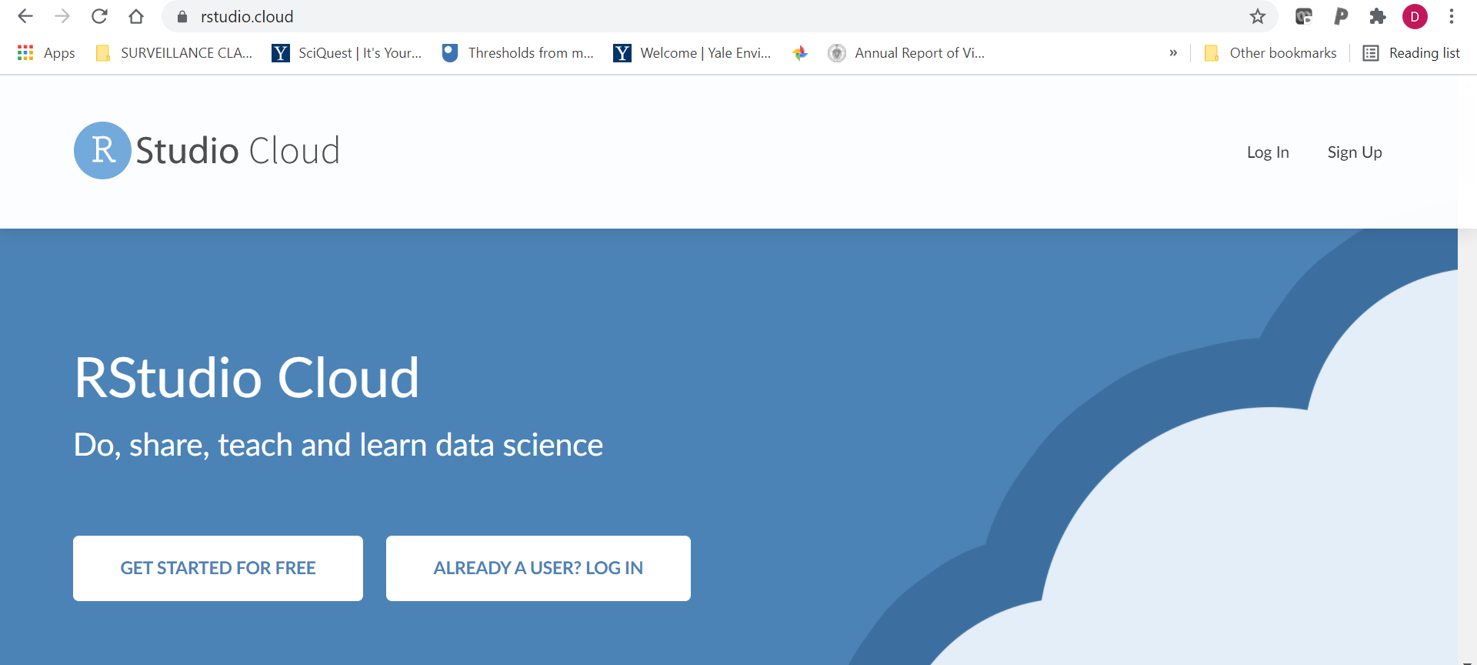
Step 1: Create a free account on the Rstudio Cloud: https://rstudio.cloud/

Slide 3
2) Join the Workspace titled “Vaccine Evaluation Workshop”
Click this link to join the work space:
https://rstudio.cloud/spaces/154746/join?access_code=5dTVayuwfwSP1FV2N1iISxhL9smlamBtZhHqq%2BX4

Slide 4
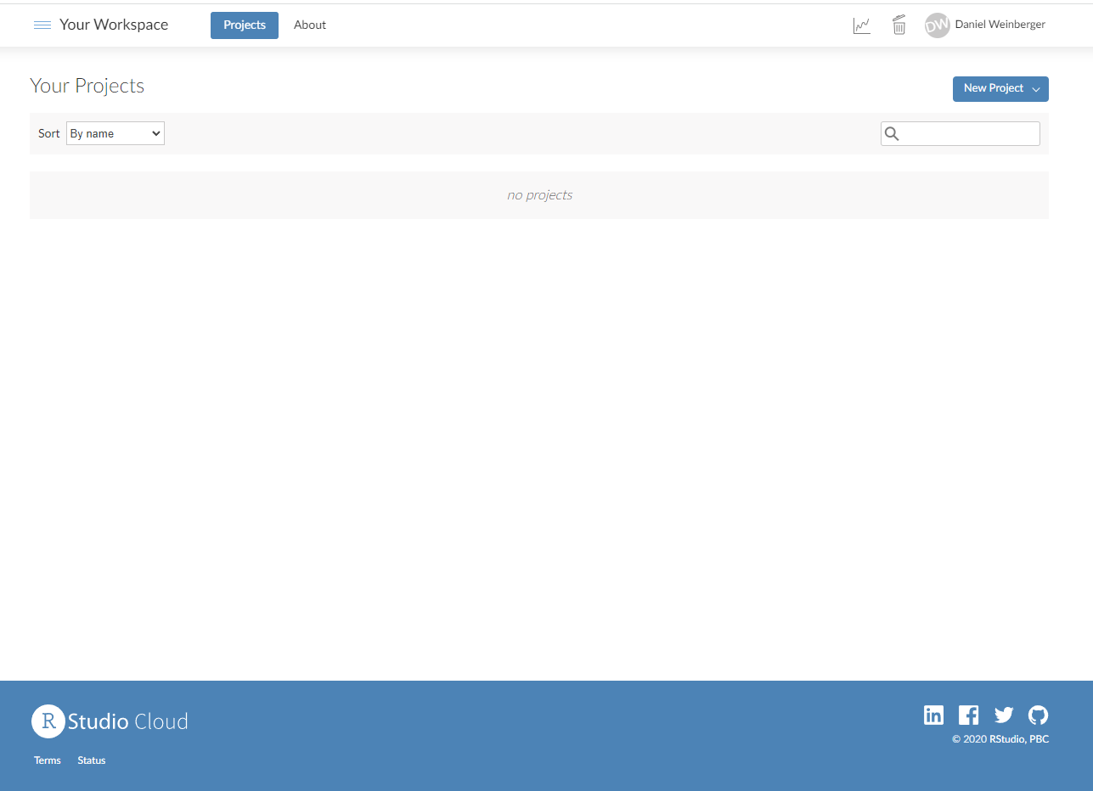
3) Access the space

Slide 5
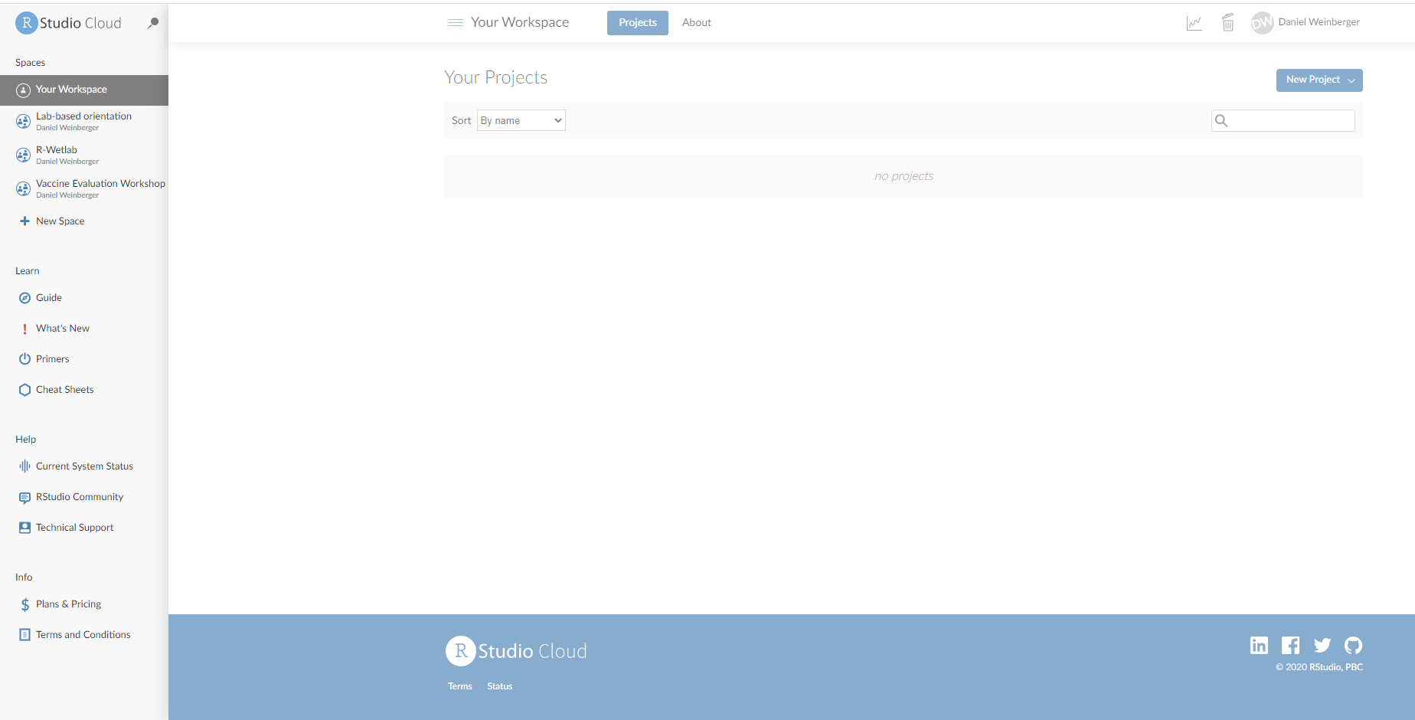
3) Access the space

Slide 6
3) Access the space

Slide 7
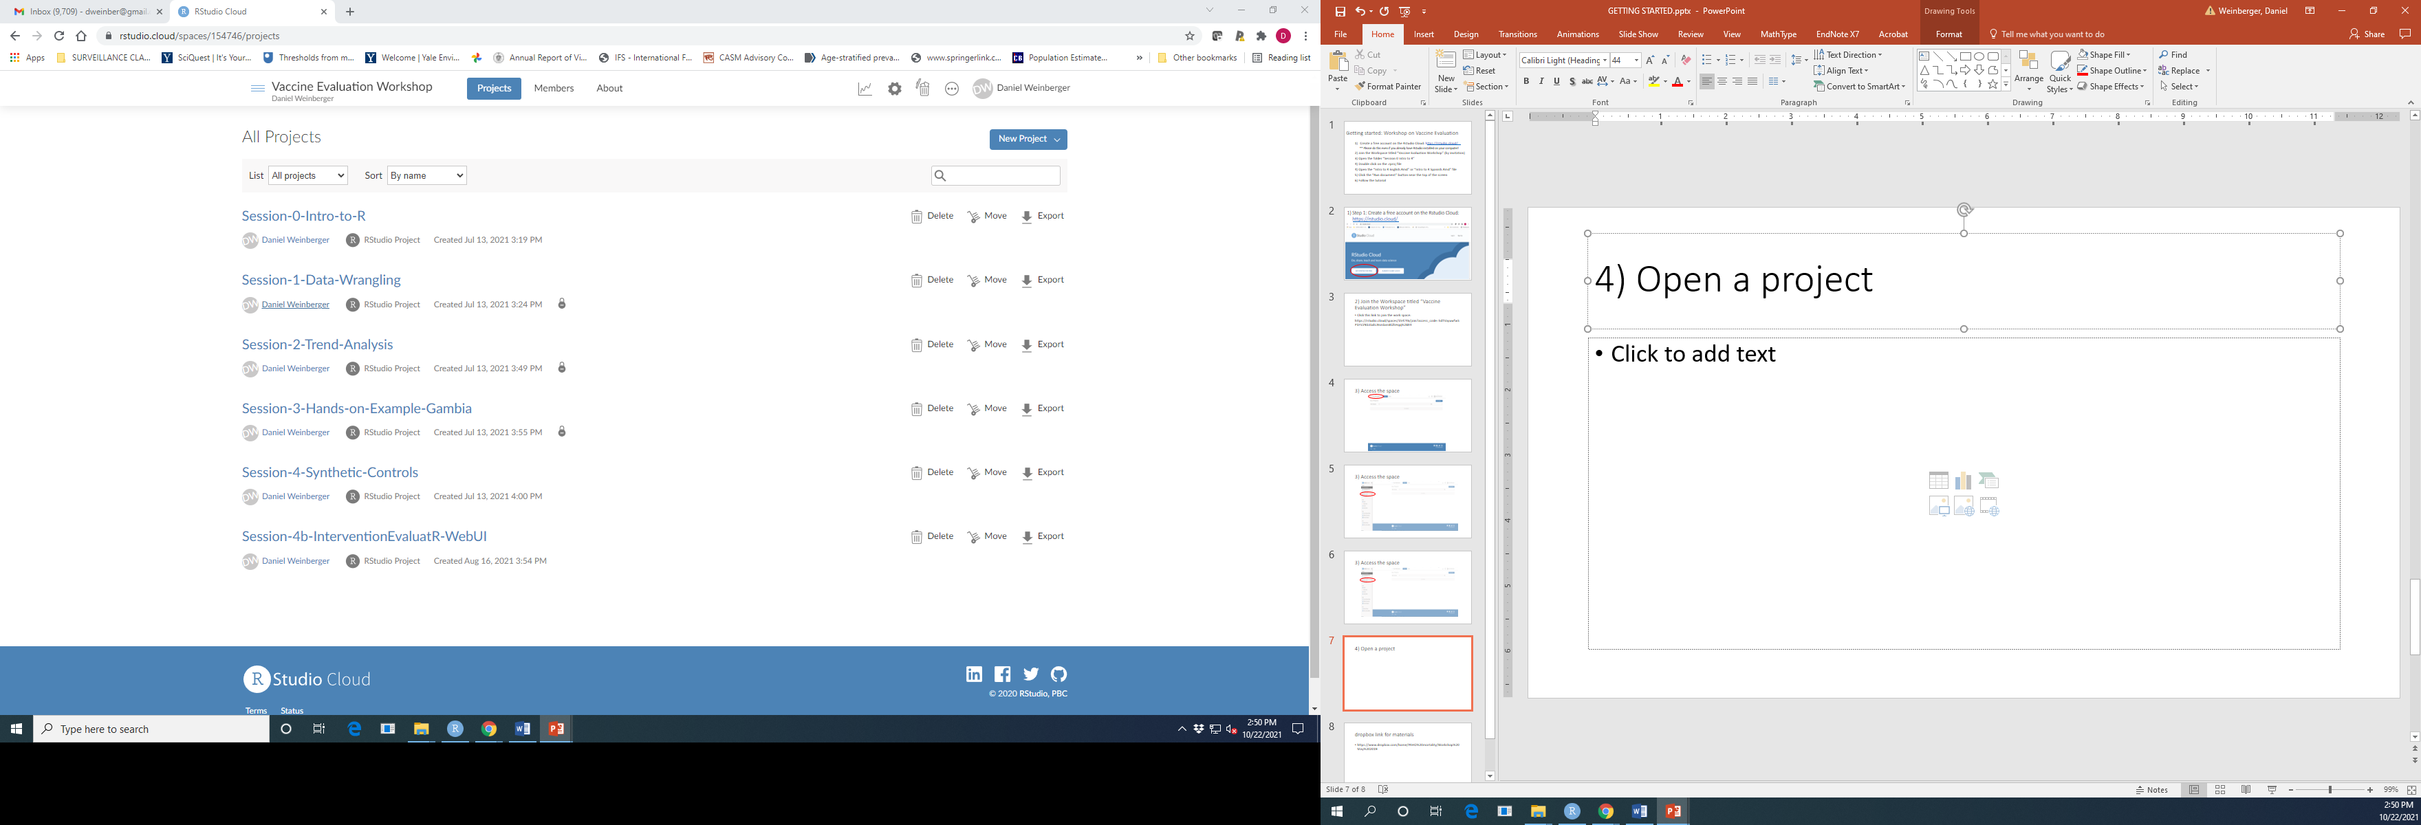
4) Open a project

Slide 8
4) Open the project ‘Session-0-Intro-to-R’

Slide 9
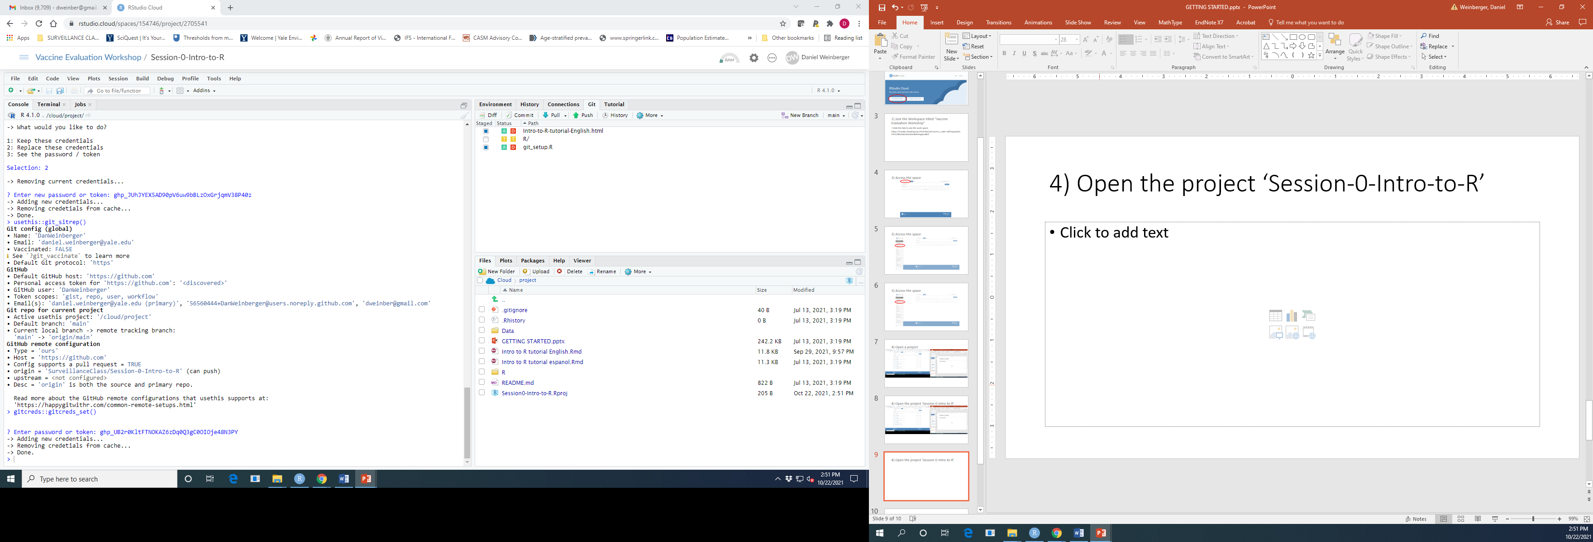
4)Open the file Intro to R tutorial English.Rmd or Intro to R tutorial Spanish.Rmd

Slide 10
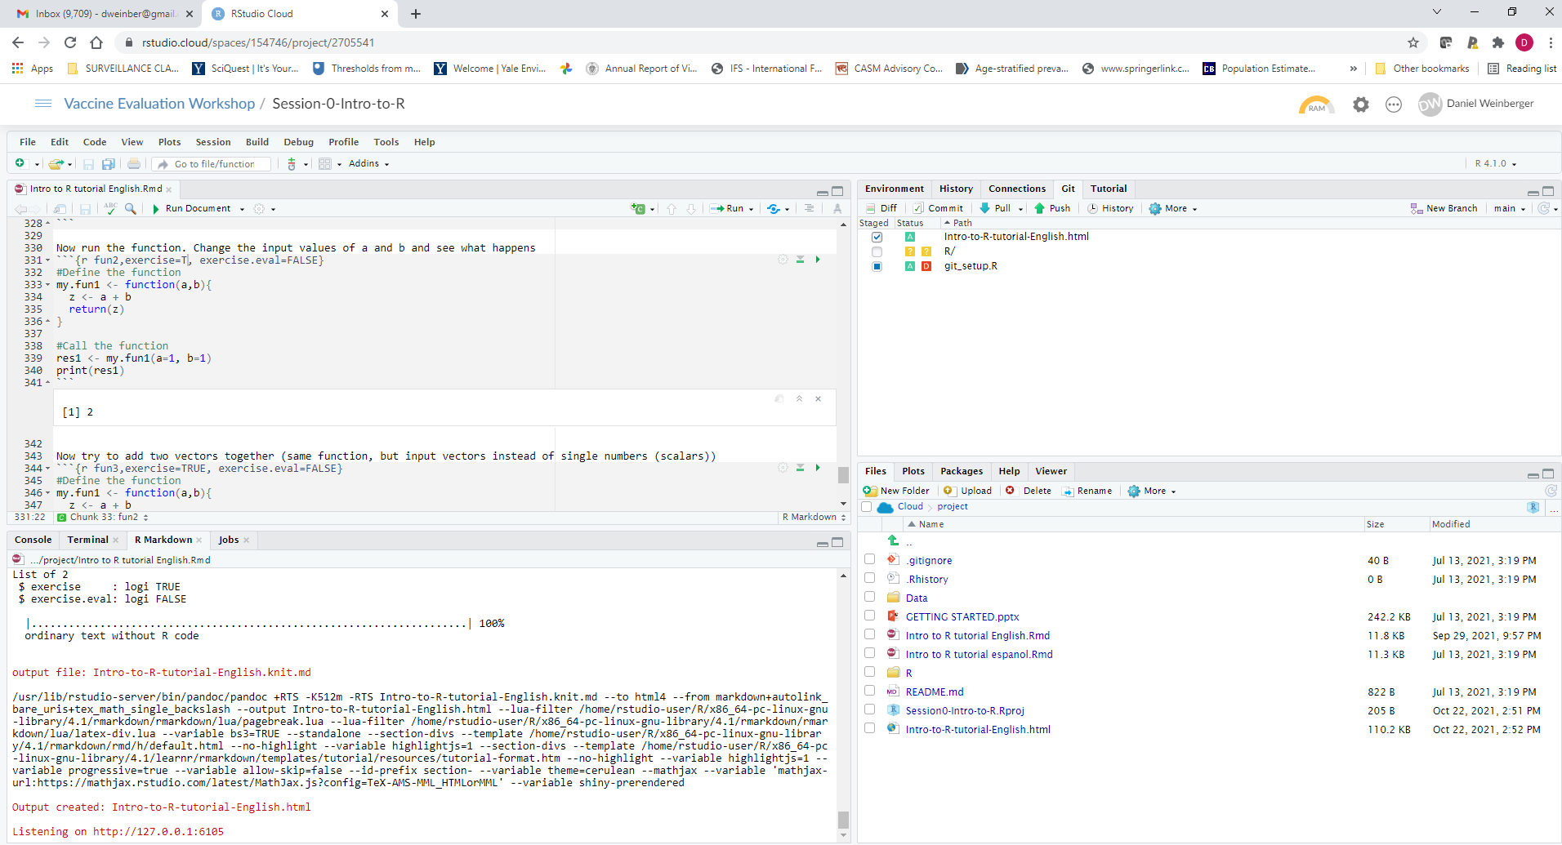
4)Click Run document

Slide 11
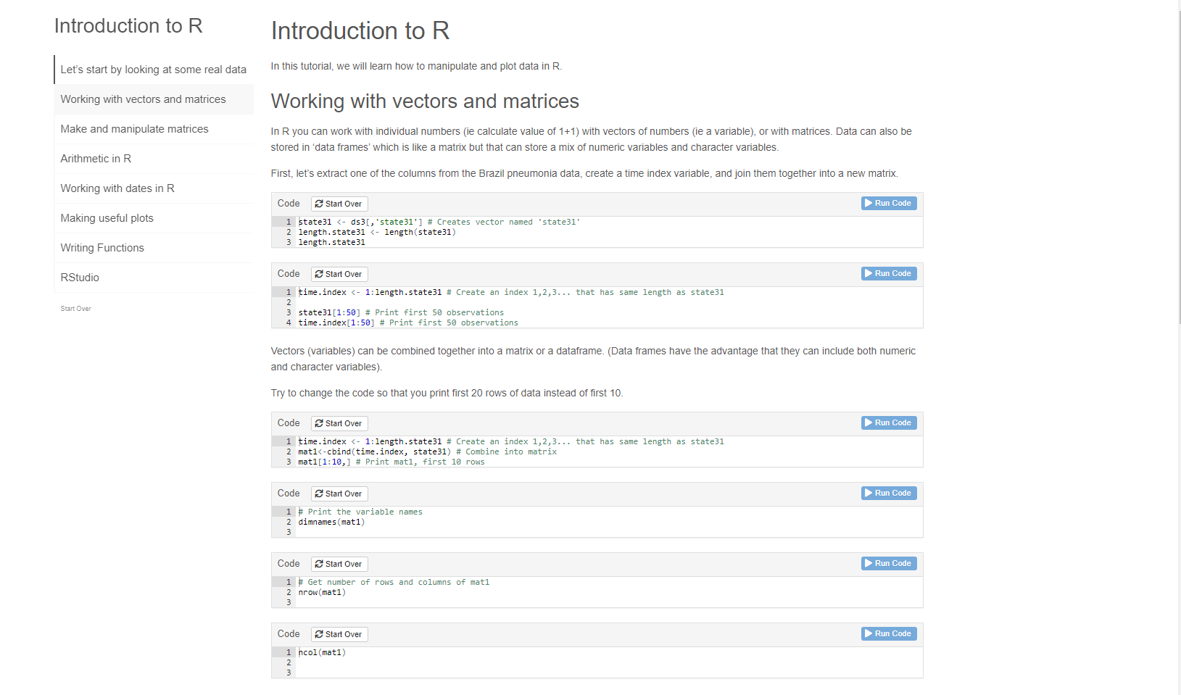
4) Follow along with the tutorial, and watch the associated video

